Slide 1
EMPLOYEE MANAGEMENT SYSTEM
( By using C Programming Language )

Slide 2
Outline
1. Introduction
2. Problem Statement
3. Objective
4. Methodology
5. Result
6. Reference

Slide 3
Problem Statement
In any organization employee management is a big problem if it still run the manual system. Therefore we have tried to develop an employee management system where any organization can find it total no of employee in a record system at glance with different employee in different position.
Employee name | Post | Code no | Phone Number
1. Shafiq Alam | Associate professor | 1001 | 01XXXXXXXXX
2. Tamim khan | Office staff | 1013 | 01XXXXXXXXX
3.Shahid Haque | Lab attendant. | 1091 | 01XXXXXXXXX
4. Moni Akter | Administrative officer | 1201 | 01XXXXXXXXX
5. Raj | Librarian | 1303 | 01XXXXXXXXX

Slide 4
Objective
Insert employee information into record system.
To update the record correctly.
Avoiding the mismanagement of paper work.
To store the information safely and correctly in a digital platform.
To reduce human effort for finding information.
Finally to make things easier.

Slide 5
Methodology
Overview
In this chapter we explain the methods that have been used to develop the project that’s are algorithm and flowchart. Algorithm is the sequential presentation of solving the program and achieving output as well as flowchart is the pictorial representation of algorithm in c program. Here we have use some defined symbol by ANSI throughout the flowchart to develop the project.

Slide 6
Algorithm
Step-1: Enter to the Record system through name and password user name and password if it is right then go to next step else return exit.
Step-2: after login successfully go to main menu and there are 5 sectors to choose
2.1 Add record
2.2 List record
2.3 Modify record
2.4 Delete record
2.5 Exit
Step-3: Choose any option as one need
3.1: If you chose 2.1 then insert name, age, basic salary, email to the record
3.2: else if you 2.2 then enlisted others information and list them.
3.3: else if you choose 2.3 then modify any employee record with extra information.
3.4: else if 2.4 is chosen we can delete any garbage value of the records system.
3.5: else choose 2.5, end of program.

Slide 7
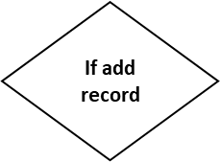

Flowchart
Start
Another = y
No
While Another = y
Yes
Read name age, salary and other
Write data file EMP.DAT
Display and another record
Yes
No

Slide 8
Start
Display Name, Salary and Age
Read file EMP.DAT
No
While data in file
Yes
Display Name, Salary and Age
Exit

Slide 9
Start
While another = y
Read emp name to modify
Read file emp.dat
If empname=name
Read new name, age, salary and others
Write data to file emp.dat
If modify another record
Exit

Slide 10
Start
Another = y
While another = y
Read emp name to delete
Set file pointer ft to temp.dat
If empname=name
Write the data to the file pointed by file pointer
Close file pointer ft && fp
Remove emp.dat
Remove emp.dat
Remove emp.dat
If delete another
Exit

Slide 11
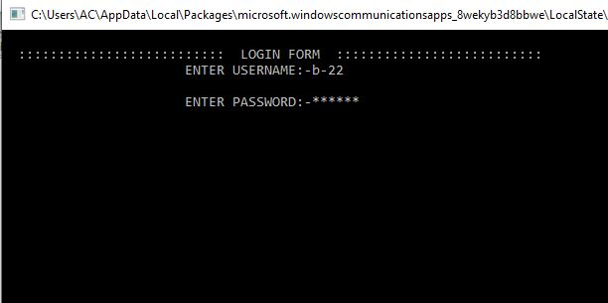
RESULT
I. LOGIN MENU:
As it is an information system, it is secured through a user name and password.

Slide 12
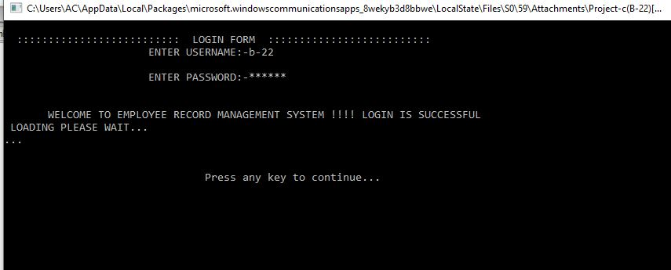
II. Welcome Menu
By logging in we are permitted to enter the record management system.

Slide 13
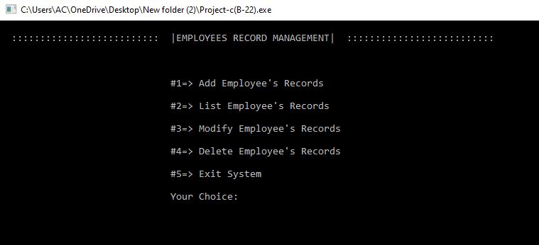
III. MAIN MENU
After login successfully, here we had five option which can be done by Adding employee record, listing record, modifing record, delete record.

Slide 14
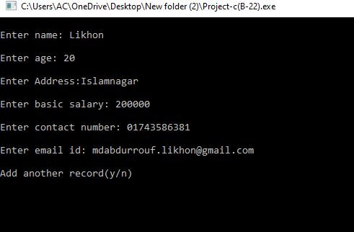
IV. Add Record
In this part we will execute the operation one by one, at first we will add information of an employee. His name, age, address, salary, contact number and email.

Slide 15
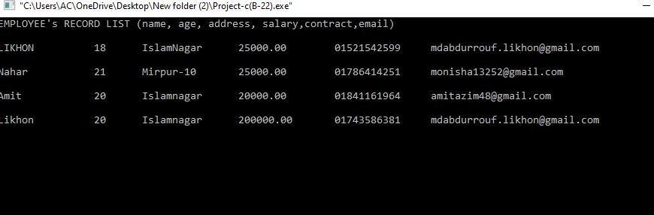
V. LIST RECORD
We will add some another employee records and listed all of added employee’s records.

Slide 16
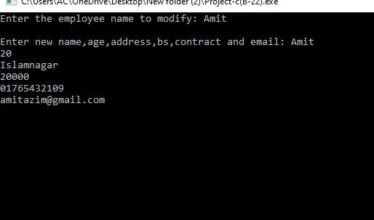
VI.MODIFY RECORD
If we need to add some extra information or modify information of employee then we modify it as.

Slide 17
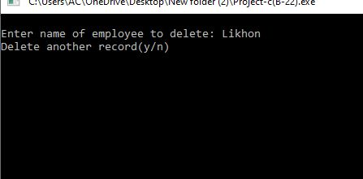
VII.DELETE RECORD
At last any retired or unauthorized employee information should delete because it is then consider as garbage value.

Slide 18
REFERENCE
Books:
[1] Programming with C – Byron Gottfried (Schaum’s Outline Series)
[2] Programing in ANSI C by Balagurusamy
Website:
[3] www.wikipedia.com [Last access on 1.03 AM, September 7, 2019]
[4] https://www.slideshare.net [Last access on 12.30 AM, September 7, 2019]

